Slide 1

RULES OF ENGAGEMENT: THE CHURCH & POLITICS
Presentation by Chris Motz

Slide 2
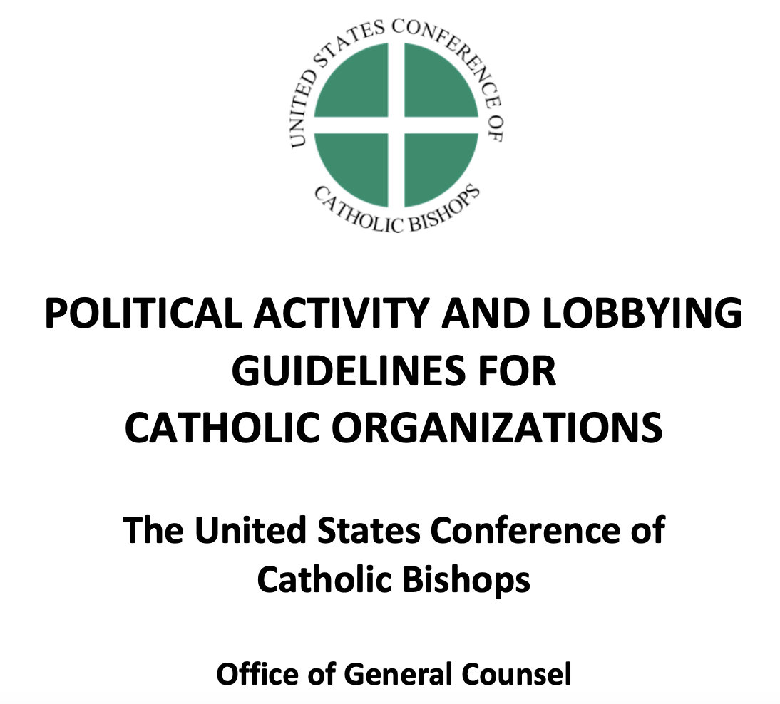
USCCB GUIDELINES

Slide 3
Ballot Measure RUles
“Catholic organizations may support or oppose ballot measures…, in furtherance of their exempt purposes, subject to the relevant lobbying limitation, without jeopardizing their tax-exempt status.”

Slide 4
WHAT IS THE “LOBBYING LIMITATION”?
“Under section 501(c)(3) [IRS Code], Catholic organizations may engage in lobbying activities if they do not constitute a substantial part of their total activities, measured by time, effort, expenditures, and other relevant factors.”
“Case law suggests…lobbying is not substantial as long as the lobbying activities constitute no more than between 5% and 15% of an organization’s total activities.”

Slide 5
PREVIOUS SD CHURCH ENGAGEMENT
AMENDMENT A
(2020)
SD Catholic Conference opposed recreational marijuana
Amendment A was APPROVED, 54% to 46%
MEASURE 27
(2022)
SD Catholic Conference opposed recreational marijuana.
Measure 27 was DEFEATED, 47% to 53%

Slide 6
OTHER STATES
In 2022, state Catholic Conference organizations and dioceses campaigned in support of three pro-life ballot initiatives (KY, MT, KS) and in opposition to three pro-abortion ballot initiatives (CA, VT, MI).
In 2023, the Catholic Conference of Ohio is actively campaigning against Issue 1, a Nov. 7 ballot measure that would enshrine abortion in the Ohio state constitution.

Slide 7

What WE Believe
”It is a part of the Church’s mission to pass moral judgments even in matters related to politics, whenever the fundamental rights of man or the salvation of souls requires it.”
- Catechism of the Catholic Church, No. 2246

Slide 8
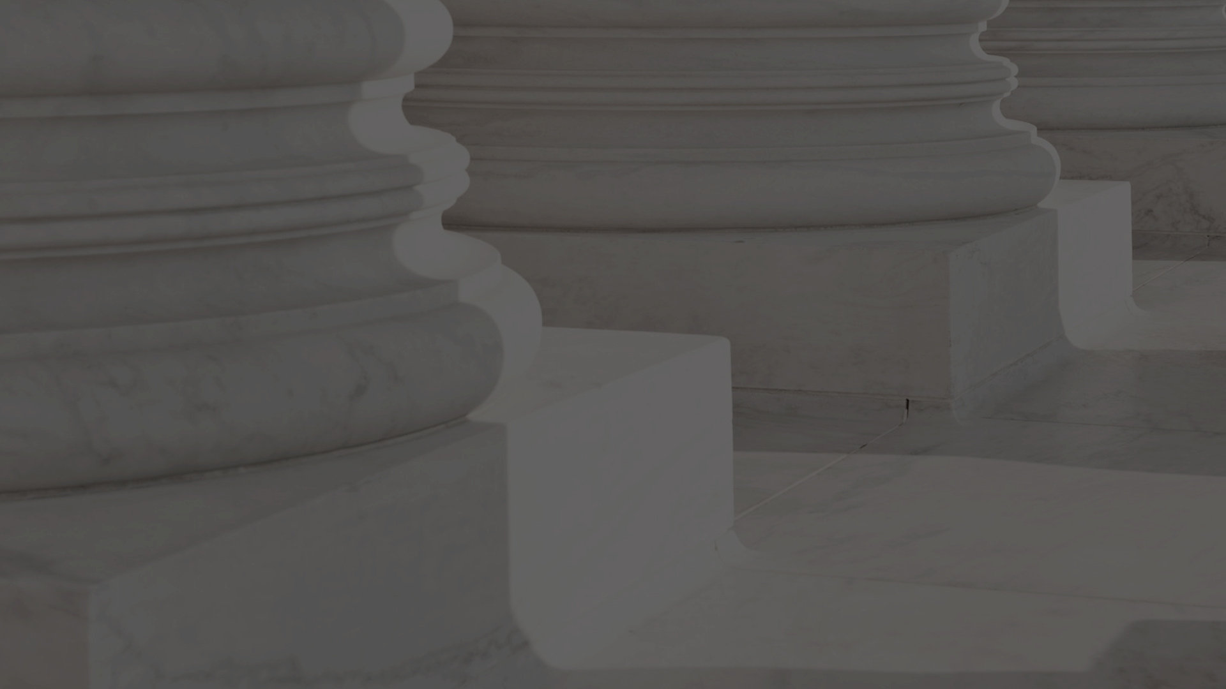
QUESTIONS

